Slide 1
Automated Handwritten Digit Recognition
Aadarsh, Ashwin, Terry, Ruida — Undergraduate
Notes:
Aadarsh

Slide 2
Overview
Can we recognize digitally drawn digits using a deep learning model trained on the cloud?
Can we train a deep neural network in a distributed fashion using Spark ML?
Goal: Allow the user to draw a digit on a webpage, and the return to the user what the digit is based on our trained model.
Experiment with approaches using Spark ML, SciKit, etc.
Achieve good performance on a testbed of user input.
Allow for a distributed workload in a cloud-based environment.
Achieve work through modern industry-tooling.
Notes:
Aadarsh

Slide 3
Rationale
Take advantage of the Spark architecture we have built so far in PA 4, as well as the automated tooling in previous PAs.
The complexity of the project necessitates four people as we are combining ideas of the cloud, distributed workloads, full-stack development, and machine/deep learning core concepts.
Match the industry way of deploying and utilizing ML models in the cloud.
Practicing using a productionised data pipeline system for real-time processing.
Combine and utilize methods in this class as capstone project.
Notes:
Aadarsh

Slide 4
Architecture Overview
Chameleon Cloud
VM2
Nginx deployment to host web services
Kafka Zookeeper
Kafka Producer
Kubernetes Managed
Consumer to get client digitally drawn digits from kafka broker and return classified output
VM3
Download MNIST dataset and create docker image
Run Spark ML pipeline distributed on workers over VM2 and VM3
Client
Send digitally drawn digits to the VMs
Notes:
Ashwin

Slide 5

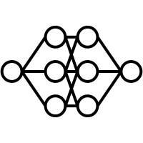
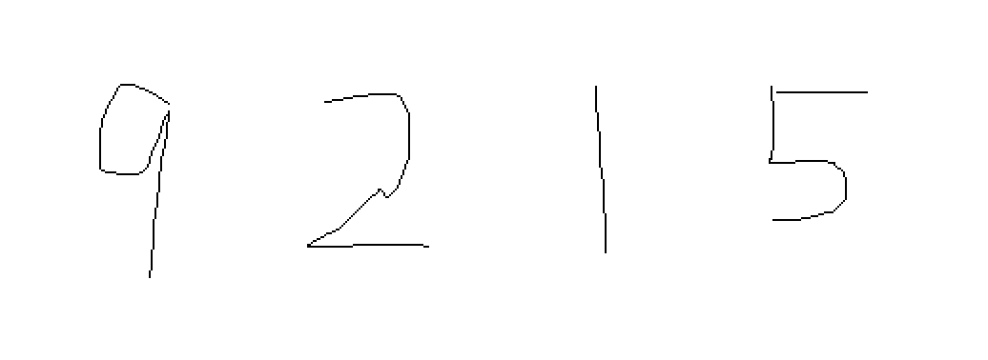
Demo
Our demo will allow a user of the application to draw digits on the webpage and obtain classifications of the drawn digits.
Fully deployed website that the user can access.
Abstraction such that the front end communicates with the server to send data.
9 2 1 5
99% Confident
Backend Cloud Deep Learning Compute
Prediction From Model Outputted On UI
User Input From Webpage
Notes:
Terry

Slide 6
Teamwork
Create A Full Stack Scaffolding, With Modern Tooling (JavaScript)
Aadarsh, Terry, Ruida
Work On Docker Containers, Kubernetes, Cloud Scaffolding Deployment (NGINX)
Ashwin, Terry
Autoscaling Based On Load
Aadarsh, Terry
Work on Spark ML Deployment, Testing, and Training
Everyone
Work On Data Collection And Preprocessing
Aadarsh, Terry
Create Web UI From Existing Frameworks (Ant Design, Bootstrap, Etc.)
Aadarsh, Ruida
Finalize Automated Pipeline Via Ansible, Vagrant
Terry, Ashwin
Test Application To Ensure Correctness
Everyone
Notes:
Terry

Slide 7
Status
We are currently in the research phase of the project and in the progress of getting all the required tools needed for development, processing, and deployment.
We already have the Chameleon VMs ready and the Kafka brokers from previous assignments.
We are currently working on the cloud deployment scaffolding code with NGINX.
We are also simultaneously working on creating docker container images to run the machine learning aspect of the code.
We are working on understanding deep learning fundamentals and common methods to deploy this to the cloud
Notes:
Ruida

